Slide 1

University Institute of Engineering
DEPARTMENT – AU1- AU5
Bachelor of Engineering
Subject Name: Mathematics-II
Subject Code: 23SMT-125
DISCOVER . LEARN . EMPOWER

Slide 2
COURSE OUTCOMES
Will be covered in this lecture
CO Number | Title | Level
CO1 | Remember the concepts based upon partial differentiation, multiple integrals and vector calculus. | Remember
CO2 | Understand the concepts of the partial differentiation, multiple integrals and vector calculus. | Understand
CO3 | Apply concepts of partial differentiation, multiple integrals and vector calculus and to use in practical problems. | Apply
CO4 | Analyze concepts of partial differentiation, multiple integrals and vector calculus and its application of analysis to Engineering problems. | Analyze
CO5 | Create the solution for real problems based upon partial differentiation, multiple integrals and vector calculus. | Applications

Slide 3
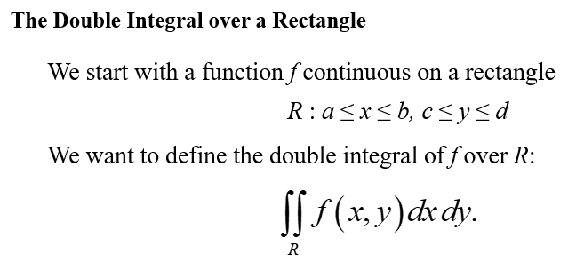
Double Integrals

Slide 4
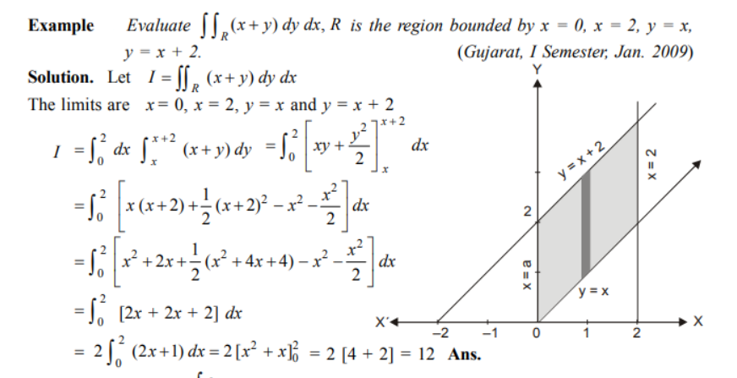

Slide 5
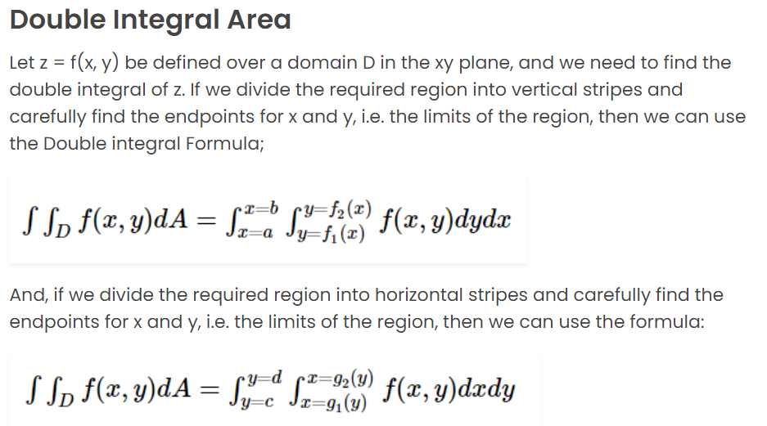

Slide 6
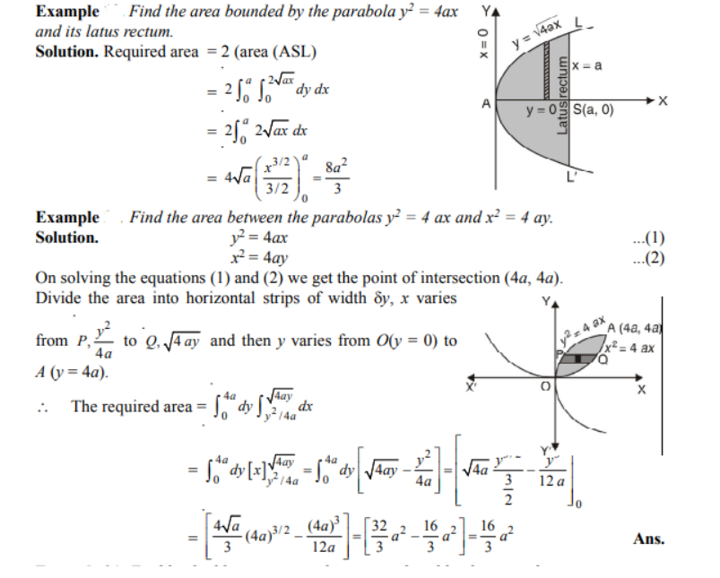

Slide 7
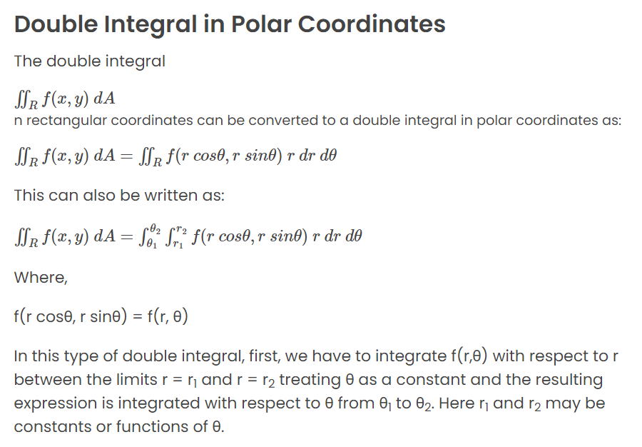

Slide 8
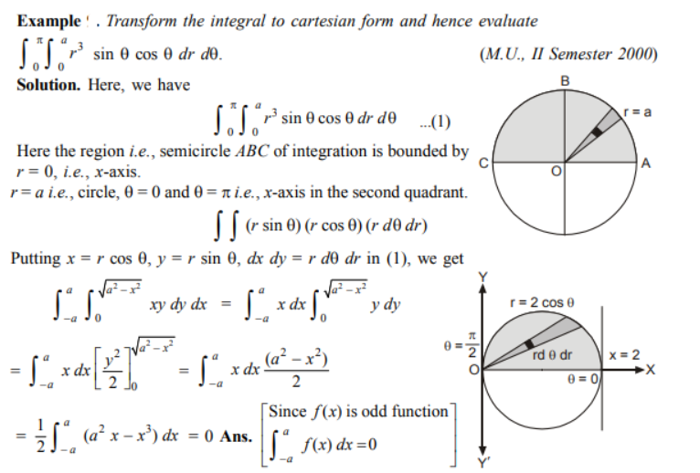

Slide 9
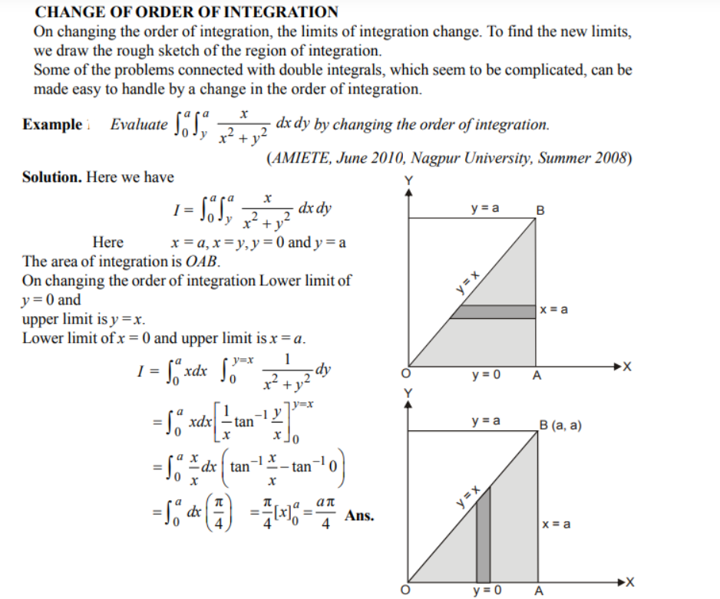

Slide 10
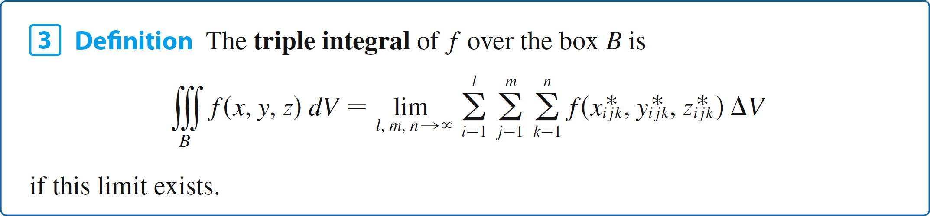
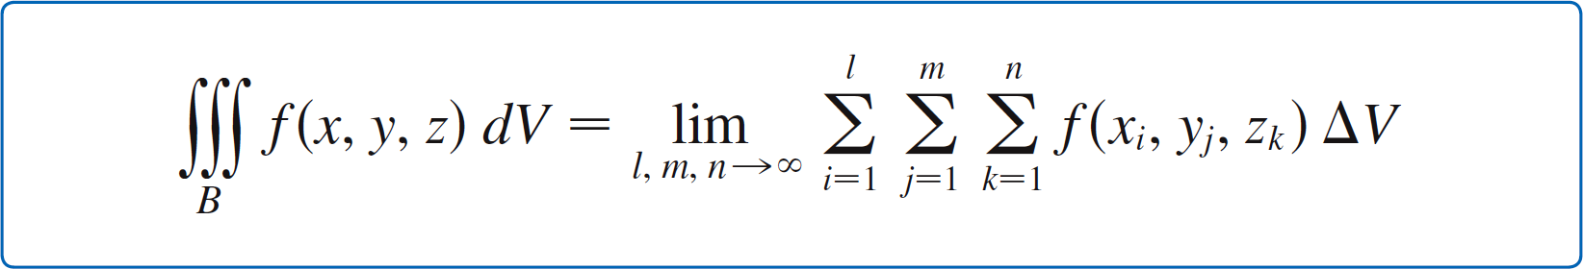
Triple Integrals
Again, the triple integral always exists if f is continuous. We can choose the sample point to be any point in the
sub-box, but if we choose it to be the point (x_{i}, y_{j}, z_{k}) we get a simpler-looking expression for the triple integral:
10

Slide 11
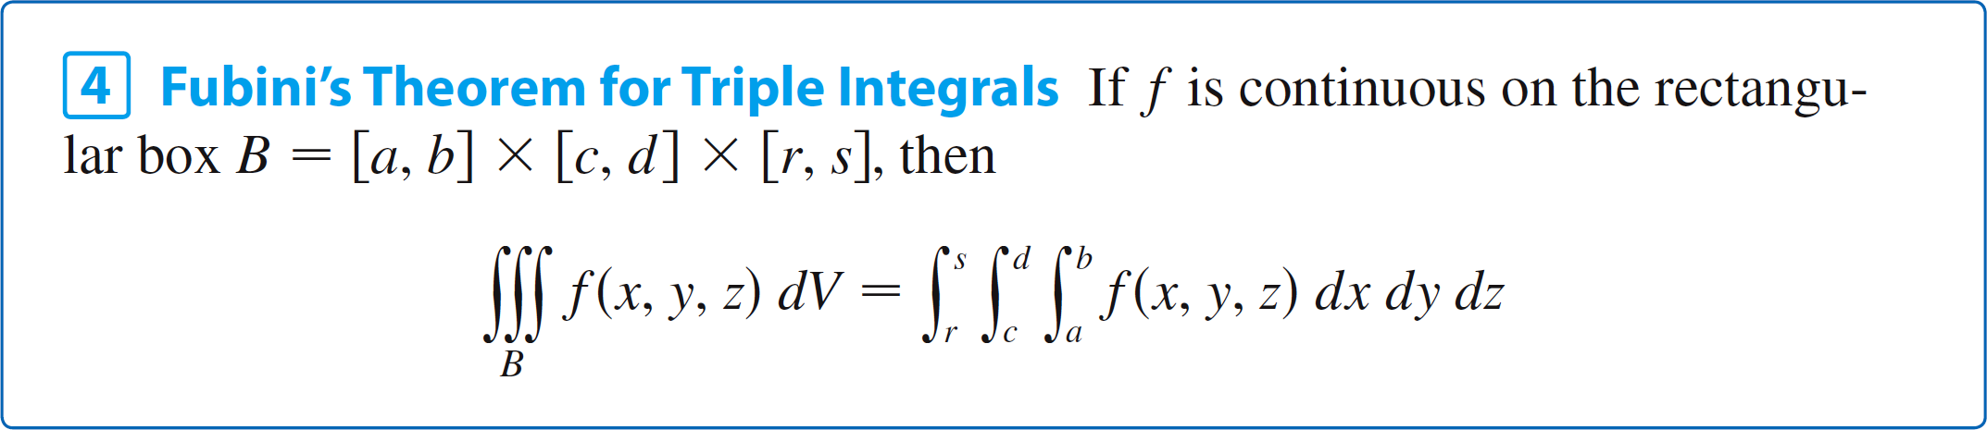
Triple Integrals
Just as for double integrals, the practical method for evaluating triple integrals is to express them as iterated integrals as follows.
The iterated integral on the right side of Fubini’s Theorem means that we integrate first with respect to x (keeping
y and z fixed), then we integrate with respect to y (keeping
z fixed), and finally we integrate with respect to z.
11

Slide 12
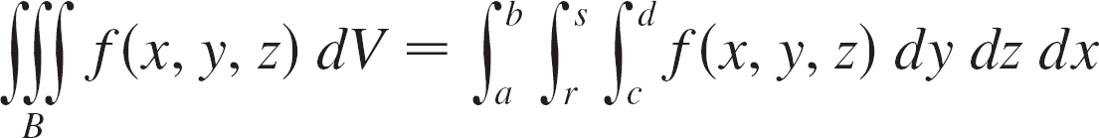
Triple Integrals
There are five other possible orders in which we can integrate, all of which give the same value.
For instance, if we integrate with respect to y, then z, and then x, we have
12

Slide 13
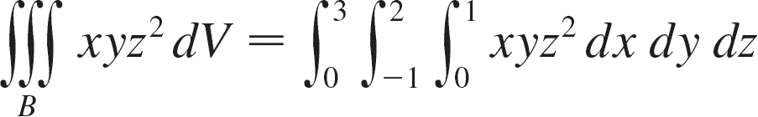
Example 1
Evaluate the triple integral ∫∫∫_{B} xyz² dV, where B is the rectangular box given by
B = {(x, y, z) | 0 ≤ x ≤ 1, –1 ≤ y ≤ 2, 0 ≤ z ≤ 3}
Solution:
We could use any of the six possible orders of integration.
If we choose to integrate with respect to x, then y, and then z, we obtain
13

Slide 14
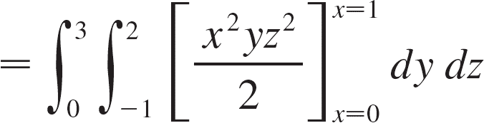
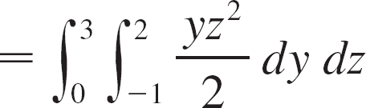
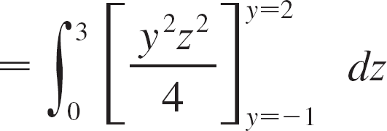
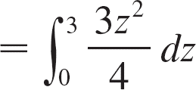
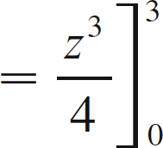
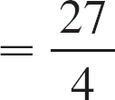
Example 1 – Solution
cont’d
14

Slide 15
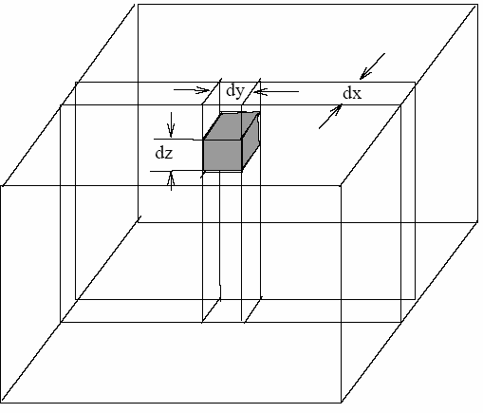
Triple Integrals in Cartesian Coordinates
The integral of a function f(x,y,z) over a 3D object D, is given by
_{∫∫∫D} f ( x, y, z)dV =_{∫∫∫D} f ( x, y, z)dxdydz
dV = dxdydz
represents an element of volume
The limits on the integration depend on the shape of the body
D
15

Slide 16
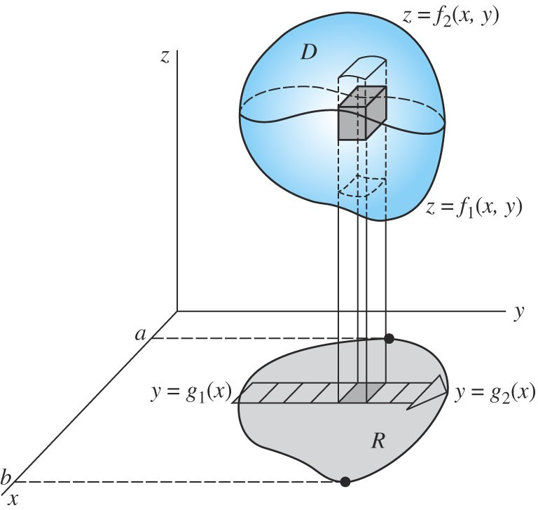
Triple integrals: limits of integration
Assuming we integrate with respect to z, then y, then x, the innermost limits may depend on the other two variables (x and y), the middle limits may depend on the outer variable (z), whereas the outer limits are constants.
The main task is to determine the correct limits on x, y, z:
_{∫∫∫D} u( x, y, z)dzdydx
∫
x=b
⎡
y = g ( x )
⎛
z= f ( x, y )
⎞
⎤
∫ ∫
=
2
⎜
2
u( x, y, z)dz dy dx
⎟
x=a ⎢⎣ y = g₁ ( x ) ⎝ z = f₁ ( x, y )
⎥⎦
For most
engineering applications shapes that are important
include: box, cylinder, cone, tetrahedron, sphere.
3

Slide 17
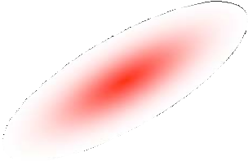
V = _{∫∫∫D} dxdydz
Engineering Application of Triple Integrals I
Volume V of a region D:
Mass for a body D with density ρ(x,y,z):
m = _{∫∫∫D} ρ ( x, y, z)dxdydz
Center of mass for a body D with density ρ(x,y,z)
_{~x = ∫ ∫∫D} xρ( x, y, z)dxdydz ,
m
_{~y = ∫ ∫∫D} yρ ( x, y, z)dxdydz _{, ~z = ...}
m
17

Slide 18
Engineering Application of Triple Integrals II
Moment of inertia about the x-axis (I_{x}) and the y-axis (I_{y}):
∫ ∫∫
( y + z )ρ ( x, y, z)dxdydz;
I =
2
2
x
D
∫ ∫∫
( x + z )ρ ( x, y, z)dxdydz,
I =
2
2
I = ..
y
D
z
Total charge for a body with charge density ρ(x,y,z)
Q = _{∫ ∫∫D} ρ ( x, y, z)dxdydz;
Total electrostatic energy (W) stored in a region with electrostatic
filed E
r 2
+
W = k
∫ ∫∫
E dxdydz;
-
D
18

Slide 19
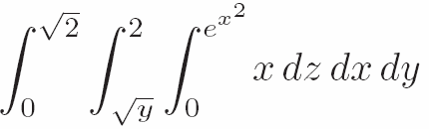
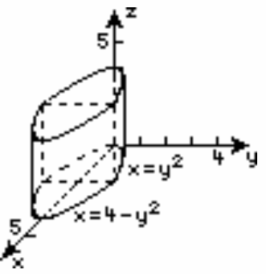
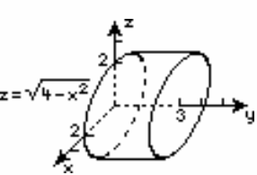
Example 1 (P9-15-6): Evaluate the integral:
Example 2 (P9-6.15)
Sketch the region D whose volume V is given by the integral:
4 3 2−2 z / 3
∫ ∫ ∫
dxdzdy
0 0 0
Example 3 (P9-15.21)
Find the volume bounded by: x=y², 4- x=y², z=0 and z=3
Example 4 (P9-15.27)
Find the center of mass of the solid bounded by: x²+z²=4,, y=0 and y=3 if the density ρ = k y
Give details of solutions
6

Slide 20
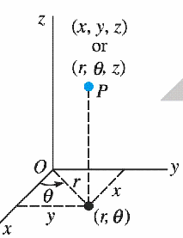
Cylindrical Coordinates
Cylindrical coordinates are good for describing solids that are
symmetric around an axis.
Naming convention: a point P(x,y,z)
⇔ (r,θ , z)
r varies from 0 to ∞; θ varies from 0 to 2π, z varies from - ∞ to ∞
Relation to Cartesian coordinates (Switching)
x = r cosθ , y = r sinθ ; z = z;
:
7
_{x}2
r = + y² ,
θ = tan⁻¹ ( y / x)

Slide 21
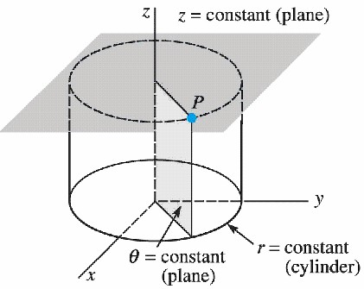
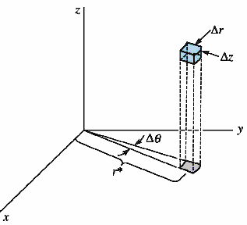
Differential length :
Cylindrical Coordinates
d^{r} = dr rˆ + r dθ θ^{ˆ} + dz zˆ
L
Differential surface(dS = dS nˆ) :
r = cons tan t, d^{r}s = r dθ dz aˆ
θ = cons tan t, d^{r}s = dr dz aˆ_{θ}
z = cons tan t, d^{r}s = r dr dθ aˆ
r
z
Differential volume : dV = r dr dθ dz

Slide 22
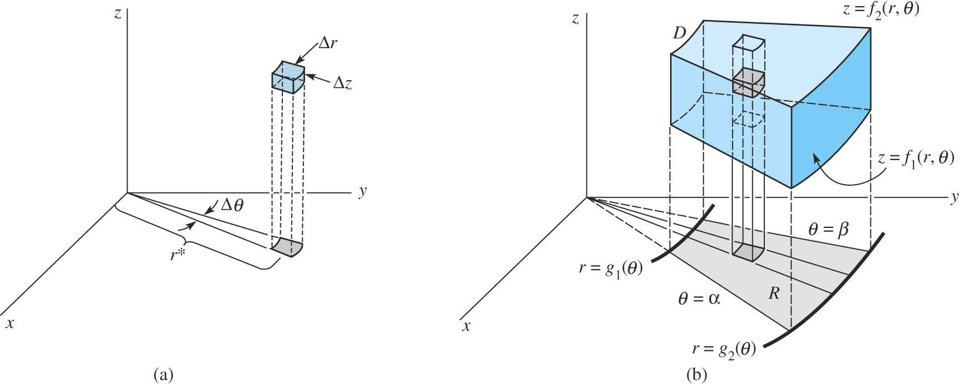
Triple Integrals in Cylindrical Coordinates
express dV as
_{∫∫∫D} f ( x, y, z)dxdydz = _{∫∫∫D} f (r cosθ , r sinθ , z)rdrdθdz
€ z-first
∫
θ = β
⎡
∫
r = g (θ )
⎛
∫
z= f ( r,θ )
⎞
⎤
=
1
⎜
2
u(r,θ , z)dz rdr d
θ
⎟
θ =α ⎢
1 ⎝ 1
⎠
⎥
⎣
r= g (θ )
z= f ( r,θ )
⎦
θ-last €

Slide 23
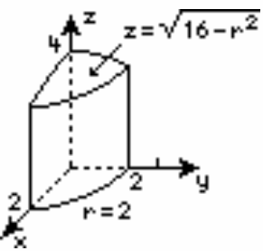
_{x}2
Example 1 (P9-15-45): Convert the following equation to cylindrical coordinates:
+ y² − z² = 1
Example 2
Use triple integrals in cylindrical coordinates to find the volume V bounded by:
x ² + y² = 4, x² + y² + z² = 16, z = 0
Give details of solutions

Slide 24
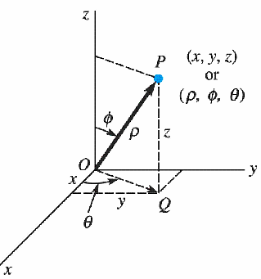
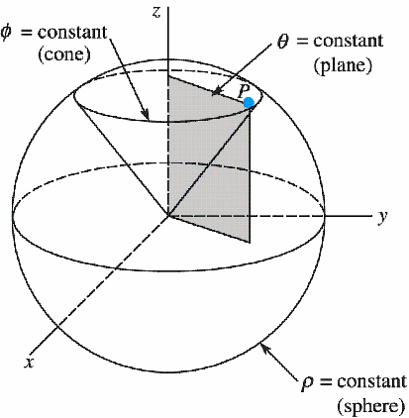
Spherical Coordinates
Spherical coordinates are good for describing solids that are symmetric around the point.
Naming convention: a point P(x,y,z)
⇔ (ρ,φ,θ )
ρ varies from 0 to ∞; φ varies from 0 to π
θ varies from 0 to 2π,
Relation to Cartesian coordinates (switching):
x = ρ sinφ cosθ , y = ρ sinφ sinθ , z = ρ cosφ
_{x}2
ρ = + y² + z² ,
θ = tan⁻¹ ( y / x),
φ = tan⁻¹(
_{x}2
+ y² / z)

Slide 25
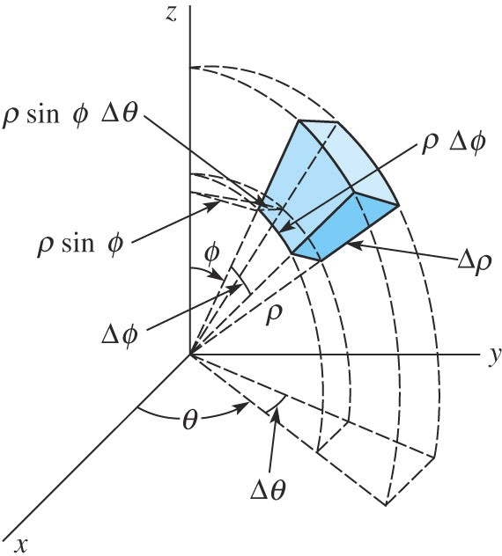
Triple Integrals in Spherical Coordinates
express dV as
∫∫∫
∫∫∫
u(ρ,φ,θ )ρ sinφdρdφdθ
f ( x, y, z)dxdydz =
2
D
D
Substitue :
x = ρ sinφ cosθ , y = ρ sinφ sinθ ,
z = ρ cosφ
∫
⎡
⎢⎣
∫
⎛
∫
⎞
2 ⎤
I =
⎜
u(ρ,φ,θ )dθ
⎟
ρ dρ sinφ
dφ
⎝
⎠
⎥⎦
θ-first €
φ-last €
25

Slide 26
Example 1: Convert the following equation to spherical coordinates:
z² = 3x² + 3y²
Example 2 Find the volume bounded by:
_{x}2
y² + z² = 4, y = x, y = 3 x, z = 0, First Octant
Example 3
Find the moment of inertia about the z axis of the solid:
x² + y² + z² = a²
The density ρ_{v} = kρ.
∫ ∫∫
( x + y )ρ ( x, y, z)dxdydz; ⇒
I =
2 2
Spherical Coordinates
z
V
v
Give details of solutions
14

Slide 27
Introduce the del operator in both cylindrical and spherical coordinates through these examples.
Optional Homework:
Given the electrostatic field E = kr³aˆ
r
Calculate the charge density ρ_{v}:
r
1 ∂ 1 ∂ ∂E r ∂r
ρ = ∇.E =
[rE ]+ [E ]+
z
v
r
r ∂θ
θ
∂r
Calculate the total charge and stored energy in a region bounded by: 0 § r § 1, 0 § θ § 2π and 0 § z § 3
Optional Homework:
Given the electrostatic field E = kρ ²aˆ_{ρ}
Calculate the charge density ρ_{v}:
1 ∂
ρ ² ∂ρ ρ sinφ ∂φ ρ sinφ ∂θ
[ρ E ]+
1 ∂ 1 ∂E
[sinφE ]+
ρ = ∇. ^{r} =
E
2
θ
v
ρ φ
Calculate the total charge and stored energy in a region bounded by: 0 § ρ § 1, 0 § φ § π and 0 § θ § 2π
15

Slide 28
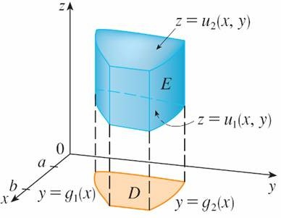
Triple Integrals
In particular, if the projection D of E onto the xy-plane is a type I plane region (as in Figure 3).
A type 1 solid region where the projection D is a type I plane region
Figure 3

Slide 29

Applications of Triple Integrals
We know that if f(x) ≥ 0, then the single integral represents the area under the curve y = f(x) from a to b, and if f(x, y) ≥ 0, then the double integral ∫∫_{D} f(x, y) dA represents the volume under the surface z = f(x, y) and above D.
The corresponding interpretation of a triple integral
∫_{E} f(x, y, z) dV, where f(x, y, z) ≥ 0, is not very useful because it would be the “hypervolume” of a
four-dimensional object and, of course, that is very difficult
to visualize. (Remember that E is just the domain of the function f; the graph of f lies in four-dimensional space.)
∫∫

Slide 30
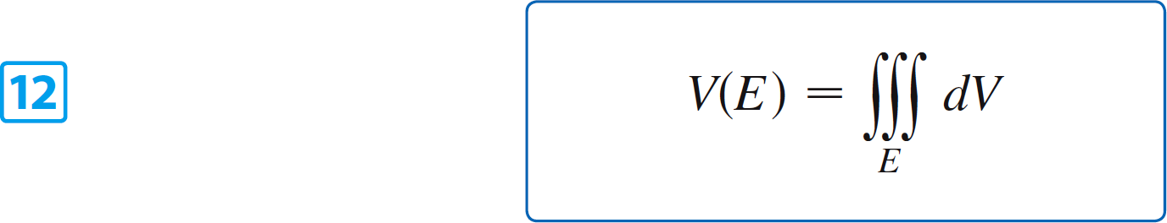
Applications of Triple Integrals
Nonetheless, the triple integral ∫∫∫_{E} f(x, y, z) dV can be interpreted in different ways in different physical situations, depending on the physical interpretations of x, y, z and f(x, y, z).
Let’s begin with the special case where f(x, y, z) = 1 for all points in E. Then the triple integral does represent the volume of E:

Slide 31
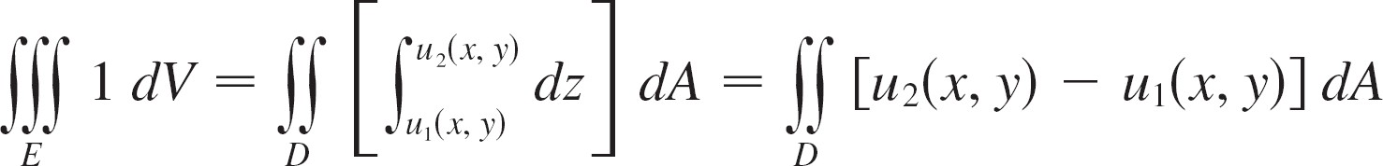
Applications of Triple Integrals
For example, you can see this in the case of a type 1 region by putting f(x, y, z) = 1 in Formula 6:
and we know this represents the volume that lies between the surfaces z = u₁(x, y) and z = u₂(x, y).

Slide 32
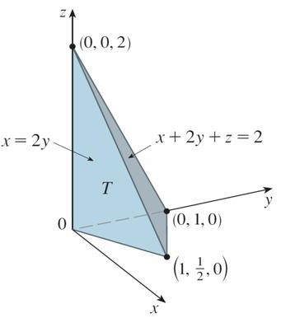
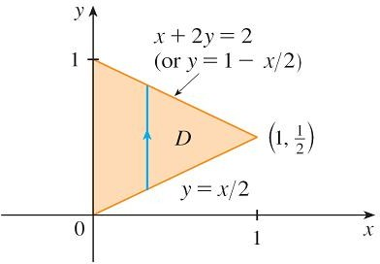
Example
Use a triple integral to find the volume of the tetrahedron T
bounded by the planes x + 2y + z = 2, x = 2y, x = 0, and
z = 0.
Solution:
The tetrahedron T and its projection D onto the xy-plane are shown in Figures 14 and 15.
Figure 14
Figure 15

Slide 33
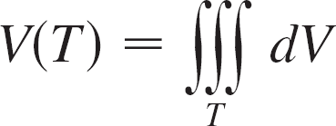
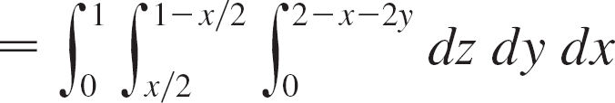
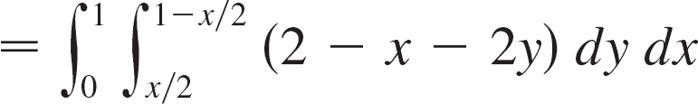

Example – Solution
cont’d
The lower boundary of T is the plane z = 0 and the upper boundary is the plane x + 2y + z = 2, that is, z = 2 – x – 2y.
Therefore we have
(Notice that it is not necessary to use triple integrals to compute volumes. They simply give an alternative method for setting up the calculation.)

Slide 34
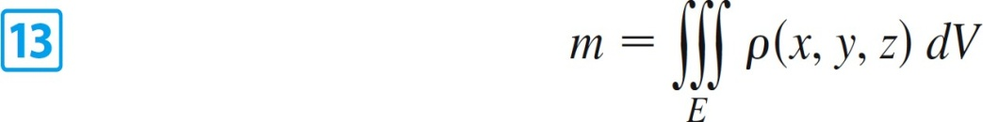
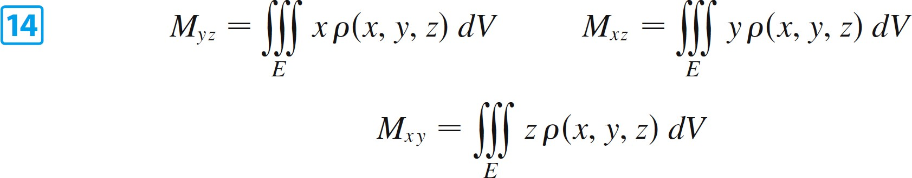
Applications of Triple Integrals
All the applications of double integrals can be immediately extended to triple integrals.
For example, if the density function of a solid object that occupies the region E is ρ (x, y, z), in units of mass per unit volume, at any given point
(x, y, z), then its mass is
and its moments about the three coordinate planes are

Slide 35

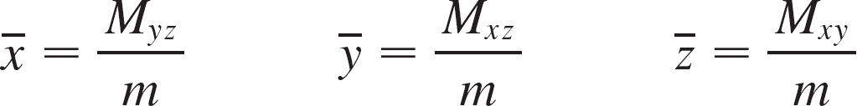

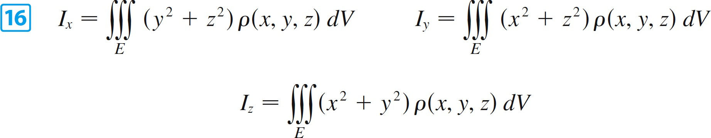
Applications of Triple Integrals
The center of mass is located at the point
where
If the density is constant, the center of mass of the solid is called the centroid of E.
The moments of inertia about the three coordinate axes are

Slide 36
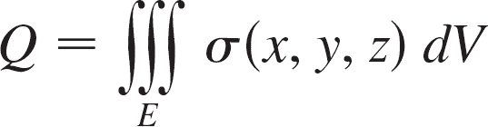
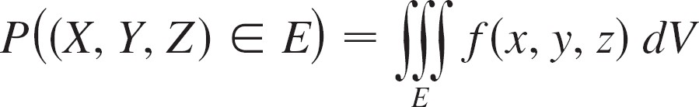
Applications of Triple Integrals
The total electric charge on a solid object occupying a region E and having charge density σ (x, y, z) is
If we have three continuous random variables X, Y, and Z, their joint density function is a function of three variables such that the probability that (X, Y, Z) lies in E is

Slide 37
Applications of Triple Integrals
In particular,
The joint density function satisfies

Slide 38

References
Books
(i)B. S. Grewal, “Higher Engineering Mathematics”, Khanna Publication, 2016.( https://www.scribd.com/document/323240170/Higher-Engineering-Mathematics-Dr-B-S-Grewal-Khanna-Publishers-pdf)
(ii) P. N. Wartikar and J. N. Wartikar, “Applied Mathematics”, Prentice Hall India, 1999.
Websites
https://en.wikipedia.org/wiki/Evolute
http://www.sakshieducation.com/Engg/EnggAcademia/CommonSubjects/M1-CurvatureEvolutes&EnvelopesCurveTracing.pdf
Video Links
https://youtu.be/H9xxLXYSrCw
https://youtu.be/WmhOVyQVveQ

Slide 39
THANK YOU

